Slide 1
Coding Standards
A Presentation by Jordan Belone

Slide 2
What are They?
Rules - Must
Guidelines - Should
Physical Document

Slide 3
Open Source
GNU
http://www.gnu.org/prep/standards/standards.html
Firefox
https://developer.mozilla.org/En/Developer_Guide/Coding_Style

Slide 4
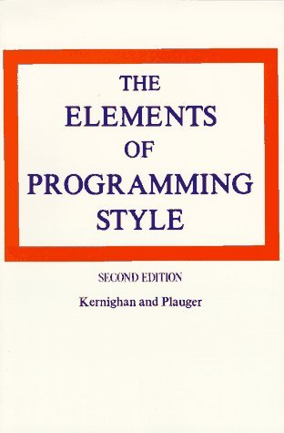
Prominent Works
Kernighan and Plauger (1974)
Fortran and PL/I
Contains important points

Slide 5
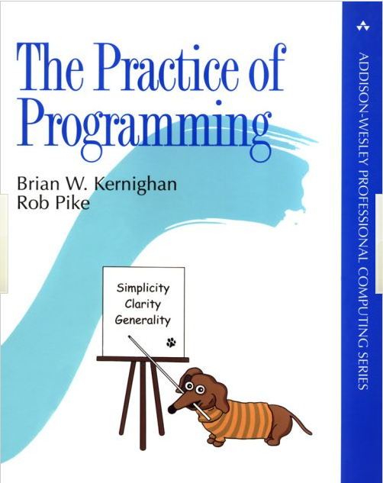
Prominent Works (2)
Rob Pike
More recent (Published in 1999)
Regarded as “a business essential” and has been proven to save money
C/C++/Java

Slide 6
Kernighan Quotations
"Where there are two bugs, there is likely to be a third.“
“Don't patch bad code - rewrite it."
"Don't stop with your first draft."

Slide 7
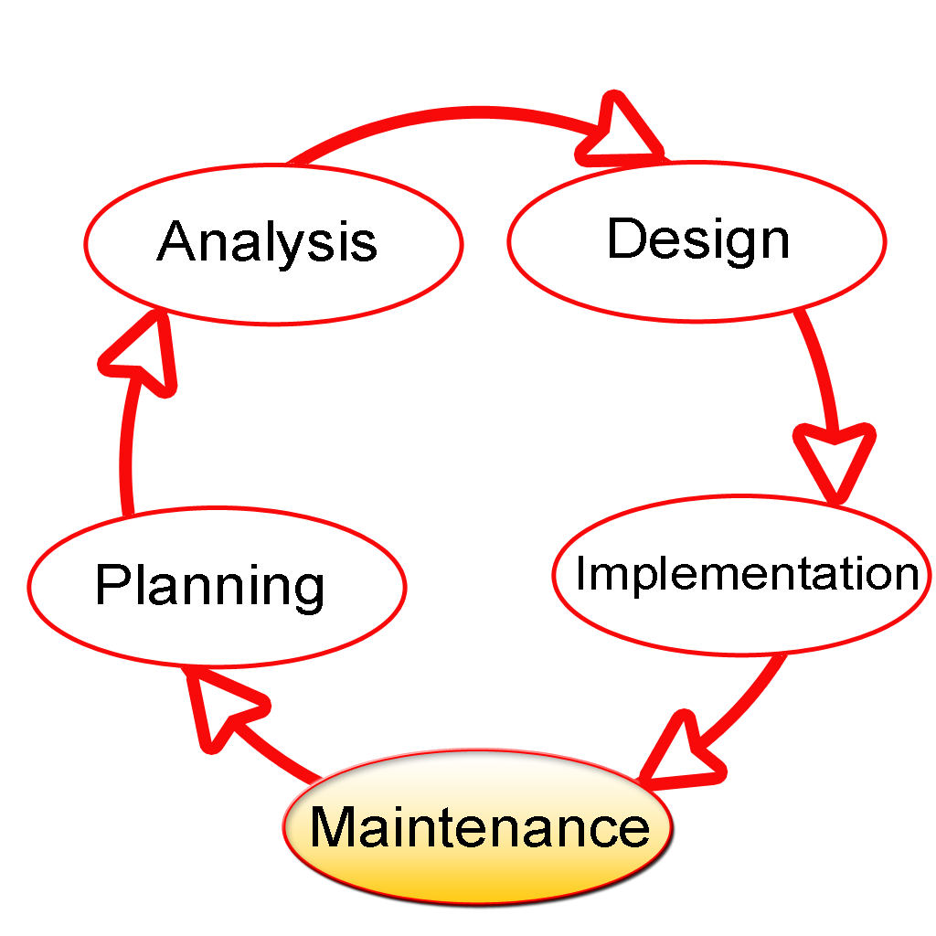
Why Have Coding Standards?
Software Maintenance
Less Bugs
Teamwork
Team switching
Cost

Slide 8
TYPES OF CONDING STANDARDS
BY COMPANY
BY LANGUAGE

Slide 9
CODING STANDARDS
EXAMPLES

Slide 10
Common Practice - Indentation
Identifies scope in some programming languages for the compiler
Indentation of
  Functions
  Objects
  Etc
Unnecessary in Freeform programming <Java>
Gives an indication of scope in freeform languages but doesn’t affect program

Slide 11
Example
Compare
To
if (g < 17 && h < 22 || i < 60) { return true; } else {System.out.println (“incorrect”) ; return false; }
if (g < 17 && h < 22 || i < 60)
{
return true;
}
else
{
System.out.println(“incorrect”);
return false;
}
Easier to Read
Easier to Understand
Easier to maintain

Slide 12
Common Practice -Commenting Code
ALL PROGRAMMING LANGUAGES
Comments should
- Clearly demonstrate the function of the code, both to yourself and to other developers
- Not too long
Comments should NOT be
- Every line (Exceptions for functional languages)
- Overcomplicated

Slide 13
Common Practice - Whitespace
Very important but often overlooked
Makes the code easier to read
Especially important with large programs, lack of whitespace can be very confusing

Slide 14
Example
for(int i=0;i<40;i++)
  {system.out.println(i);}
for( int i = 0 ; i < 40 ; i++ )
{
  system.out.println(i);
  }

Slide 15
Common Practice – Naming Variables
Variable names are often thought to be less important but they are vital to understanding certain pieces of code.
In the majority of programming languages, variables can be assigned almost any name.

Slide 16
Example
If(a < h && z <o && t<e)
{
return true;
}
else
{
return false;
}
This code could do anything!

Slide 17
Example quotations from different coding standards
Use spaces not TABs.
Three character indent (four is more common; get agreement and enforce with a tool).
No long lines. Limit the line length to a maximum of 120 characters.
No trailing whitespace on any line.
Put brace on a new line.
Single space around keywords, e.g. if (.
Single space around binary operators, e.g. 42 + 69
No space around unary operators, e.g. ++i
No space before parentheses with functions/macros, e.g. fred( 42, 69 )
Single space after parentheses with functions/macros, e.g. fred( 42, 69 )
Single space after comma with functions/macros, e.g. fred( 42, 69 )
Layout lists with one item per line; this makes it easier to see changes in version control.
One declaration per line.
Function calls with more than two arguments should have the arguments aligned vertically.
Avoid big functions and methods. Ditto for large classes and large files.
Avoid deep nesting.
Always use braces with if statements, while loops, etc. This makes changes shorter and clearer in version control.

Slide 18
SUMMARY
EASE OF INFORMATION EXTRACTION
LOOKING FORWARD

